Slide 1
Healthcare Price Dispersion
in USA
Ben Lamkin, David Johnson, Kabao Xiong and Renata Sant’Anna

Slide 2
Motivation
Are there differences in diagnosis/procedure average prices:
Between different states in the USA?
Between different regions in TN?
Between different providers in Nashville?
Is there a correlation between volume (discharge of patients) and price?
Outcomes: Heart failure, Drug poisoning and Alcohol/ Drug abuse or dependence
Notes:
Research Questions:
Are there going to be differences in diagnosis/treatment prices within the State of TN ?
Are there going to be differences in diagnosis/treatment prices ?
Is there a correlation between volume (discharge of patients) and price?
We have to explain why we want these questions answered.
So… We want these questions answered because:
Heart failure--it’s very common and we want to know what it looks like in Nashville.
Drug Abuse/Poisoning and Toxic Effects of drugs--we found these DRGs to be quite interesting topics in the bunch of DRGs and we’d also like to see it from a nashville perspective…...?

Slide 3

Dataset Summary - Entire Database
Dataset provided by CMS: Data.CMS.gov | Data (public available and updated periodically)
API Route! url: https://https://data.cms.gov/resource/tcsp-6e99.json/resource/tcsp-6e99.json
196,325 observations
Notes:
Comments: On the entire dataset, we have almost 600 unique diagnosis, from more than 3,000 providers (hospitals), across all 51 states in the USA. From the discharge count, which means visits to the hospitals, we can see that there are more than 7M of these, and the average charged price across the entire dataset is around $61k.

Slide 4
Tennessee Data
Nashville Data
Notes:
Comments: For the TN dataset, we have 88 unique providers for 367 different types of diagnosis/ procedure in 8 unique regions in TN (like: Memphis, Knoxville, Nashville and so on).
Total number of hospital visits is 194,421 and the average price charged for a diagnosis based on the TN dataset is around $54k.
Nashville has almost half of the number of the providers (hospitals) in whole TN, across different zip codes.
Total number of hospital visits in Nashville is about 77k and the average price
charged by hospitals are almost the same of the TN region: around $54k.

Slide 5
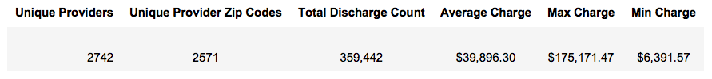
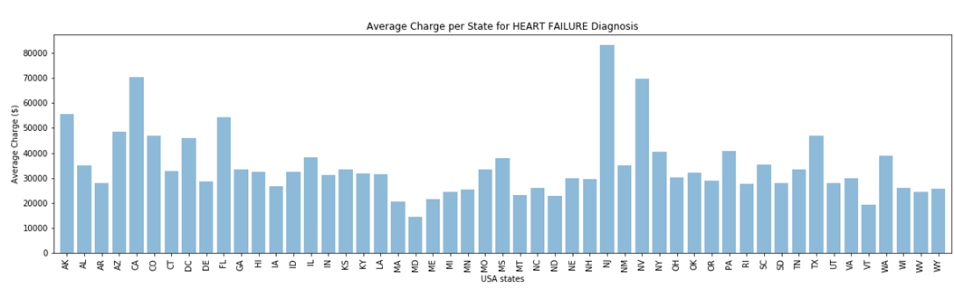
Are there differences in average prices for a HEART FAILURE diagnosis/procedure across the USA?
Notes:
Comments: New Jersey (NJ), followed by California (CA) and Nevada (NV) are among the states that charged the highest amount for a heart failure diagnosis/ procedure, around $80,000.
On the other hand, Maryland (MD) and Vermont (VT) are among the states that charged the lowest price for a heart failure diagnosis/ procedure, less than $20,000.

Slide 6
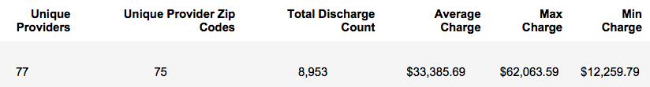
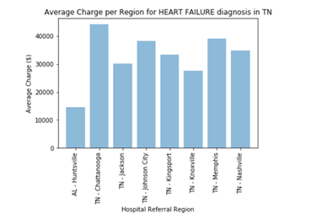
Are there differences in average prices for a HEART FAILURE diagnosis/procedure in Tennessee?
Notes:
Comments: Given 77 different providers, located in 75 unique zip codes in TN region, Chattanooga and Memphis seems to have the higher prices charged for a Heart Failure diagnosis/ procedure, around $40,000.
Huntsville, AL is also on this database because, for cardiovascular diagnosis, is common to use the hospital referral region. Depending on how complicated the case is and the specialty needed, it is recommended to cross the state boarders for the best procedure. Huntsville, AL reports the lowest average charges, less than $15,000 followed by Knoxville, TN, of about $28,000.

Slide 7

Are there differences in average prices for a HEART FAILURE diagnosis/procedure in Nashville - TN?

Slide 8
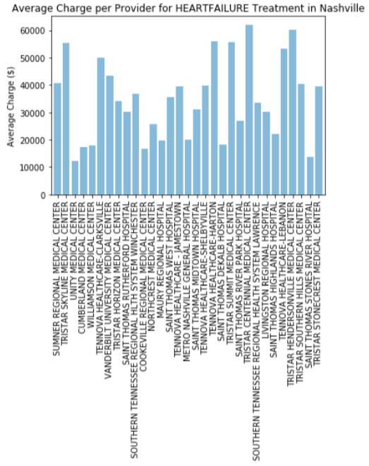
Heart Failure
(Nashville)
Notes:
Comments: Analyzing 31 unique providers in Nashville (metropolitan area) in 31 unique zip codes, around 3,000 hospital visits, Tristar Centennial Medical Center charged the highest price among all others, about $60,000. On the other hand, Unity Medical Center charged a little more than $10,000.
Tristar centennial medical center charged the highest price among all others analyzed providers in Nashville.

Slide 9
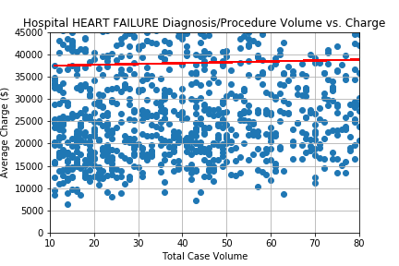
Is there a correlation between the VOLUME OF HOSPITAL VISITS vs HOSPITAL AVERAGE CHARGED PRICES for HEART FAILURE diagnosis/ procedure?
Correlation = 0.1050 (weak positive correlation)
Notes:
Comments: The scatter plot above shows a really spread data and we can say that there is a weak positive correlation, of 0.1050, among volume hospital visits and average charged prices of the providers, meaning that the relationship is not too strong, even though they tend to move together to the same direction.

Slide 10
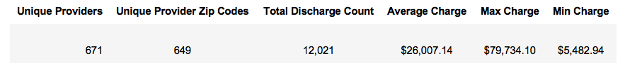
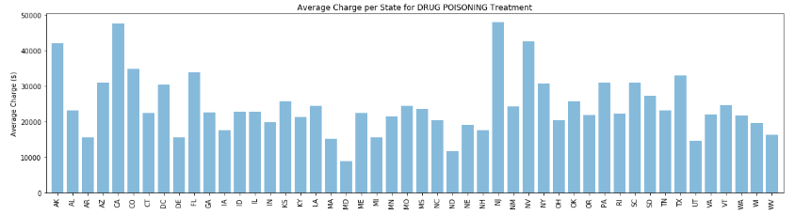
Are there differences in average prices for a DRUG POISONING diagnosis/procedure across the USA?
Notes:
Comments: The average charge amount by state for Drug Poisoning Treatment varies significantly across the country ranging from about $9k to up to nearly $50k. Alaska, California, New Jersey and Nevada stick out as charging the most with having average charge amounts greater than $40k for Drug Poisoning Treatment. This compares to the Average of about $23k from Hospitals in TN. Maryland has the lowest average at about $9k.

Slide 11

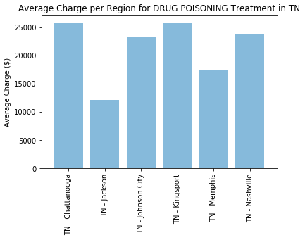
Are there differences in average prices for a DRUG POISONING diagnosis/procedure in Tennessee?
Notes:
Drug Poisoning diagnosis data for the Tennessee region
Comments: The bar chart above is looking specifically at the average charge of drug poisoning treatment by hospitals by Region in Tennessee. Even within the state there is a wide range of average charges with the lowest in Jackson at just over $10k and the highest in Chattanooga and Kingsport at about $26k. The average cost in Nashville is about $24k.

Slide 12
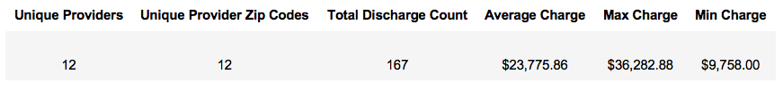
Are there differences in average prices for a DRUG POISONING diagnosis/procedure in Nashville - TN?
Notes:
Drug Poisoning diagnosis data for Nashville - TN

Slide 13
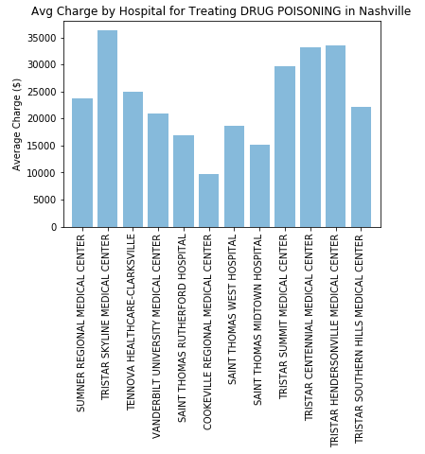
Are there differences in average prices for a DRUG POISONING diagnosis/procedure in Nashville - TN?
DRUG POISONING
(Nashville)
Notes:
Comments: The bar chart above is looking specifically at the Average Charge of Drug Poisoning Treatment by Hospitals in Nashville. This shows that even within Nashville there is a wide range of Charges ranging from about $10k at Cookeville Regional Medical Center to over $35k at Tristar Skyline Medical Center Hospital.

Slide 14
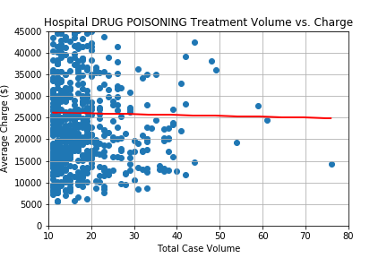
Is there a correlation between the VOLUME OF HOSPITAL VISITS vs HOSPITAL AVERAGE CHARGED PRICES for DRUG POISONING diagnosis/ procedure?
Correlation = -0.011 (weak negative correlation)
Notes:
Correlation = -0.011 (weak negative correlation)
Comments: The above scatter plot with the linear regression shows the average charge amount for drug poisoning treatment among hospitals across the country along with the associated hospital’s average case volume for Drug Poisoning treatment. This indicates a very weak negative correlation, of -0.011 that hospitals with higher Drug Treatment volume charge less (the dots start to get lower avg charges as Total Case Volume increases to the right); however, for the most part it shows that for hospitals that have a relatively low volume there is a wide range of charges for Drug Poisoning treatment ranging from around $5k to up to $45k.

Slide 15

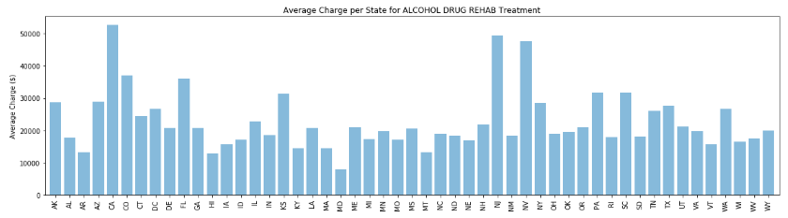
Are there differences in average prices for a ALCOHOL/DRUG ABUSE OR DEPENDENCE diagnosis/procedure across the USA?
Notes:
Comments: The bar chart above shows how the average charge amount by state for alcohol drug rehab treatment varies significantly across the country ranging from about $8k to up to nearly $53k. California, New Jersey and Nevada stick out as charging the most with having average Charge Amounts greater than $40k for Drug Poisoning Treatment. This compares to the Average of about $26k from Hospitals in TN. Maryland has the lowest average at about $8k.

Slide 16

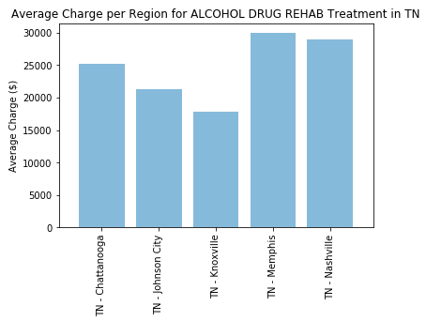
Are there differences in average prices for a ALCOHOL/DRUG ABUSE OR DEPENDENCE diagnosis/procedure in Tennessee?
Notes:
Comments: The bar chart above is looking specifically at the Average Charge of Alcohol Drug Rehab Treatment by Hospitals for the Regions within Tennessee. This shows that even within the state there is a wide range of average Charges with the lowest in Knoxville at about $18k and the highest in Memphis and Nashville at about $30k.

Slide 17

Are there differences in average prices for a ALCOHOL/DRUG ABUSE OR DEPENDENCE diagnosis/procedure in Nashville?

Slide 18
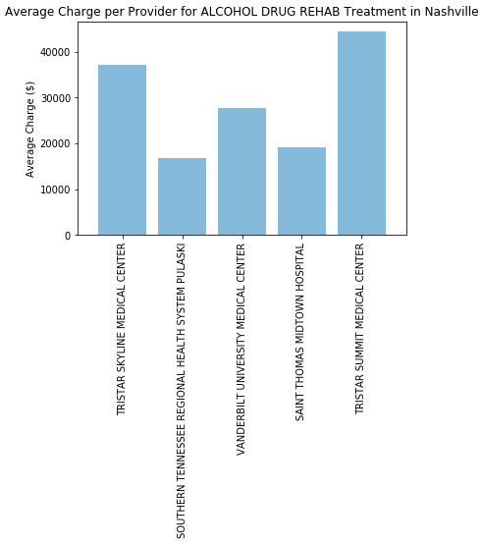
Are there differences in average prices for a ALCOHOL/DRUG ABUSE OR DEPENDENCE diagnosis/procedure in Nashville - TN?
Notes:
Comments: The bar chart above is looking specifically at the Average Charge of Alcohol/Drug Abuse or dependence diagnosis/ procedure by Hospitals in Nashville. This shows that even within Nashville there is a wide range of Charges ranging from about $17k at Southern Tennessee Regional Health System Pulaski to over $44k at Tristar Summit Medical Center.

Slide 19
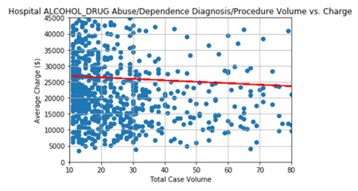
Is there a correlation between the VOLUME OF HOSPITAL VISITS vs HOSPITAL AVERAGE CHARGED PRICES for ALCOHOL/DRUG ABUSE OR DEPENDENCE diagnosis/ procedure?
Correlation = -0.01666 ( slightly negative)
Notes:
The scatter plot above shows the average Charge Amount for Alcohol Drug Rehab Treatment among Hospitals across the country along with the associated hospital’s average case volume for Alcohol Drug Rehab Treatment. This indicates a slight correlation that hospitals with higher Alcohol Drug Rehab Treatment volume charge less (the dots start to get lower avg charges as Total Case Volume increases to the right); however, for the most part it shows that for hospitals that have a relatively low volume there is a wide range of charges for Drug Poisoning treatment ranging from below $10k to above $100k.

Slide 20
Conclusion
Are there going to be differences in diagnosis/treatment prices by region?
Are there going to be differences in diagnosis/treatment prices within the State of TN?
Is there a correlation between volume (discharge of patients) and price?
Notes:
Did we get any answers to our questions? Did we get more than the info we wanted?
What are some interesting things that we discovered?

Slide 21
Thank you!
Any Questions?
Any Questions?

